Slide 1

Fault Tolerance in Cloud Computing
Building Systems That Last

Slide 2
Cloud Performance
Cloud performance focuses on how well cloud services behave under real-world conditions.
It mainly includes:
Service Availability Ensuring services are accessible when users need them
Reliability Ensuring systems operate correctly over time without frequent failure
Fault Tolerance Ensuring the system continues working even when failures occur

Slide 3
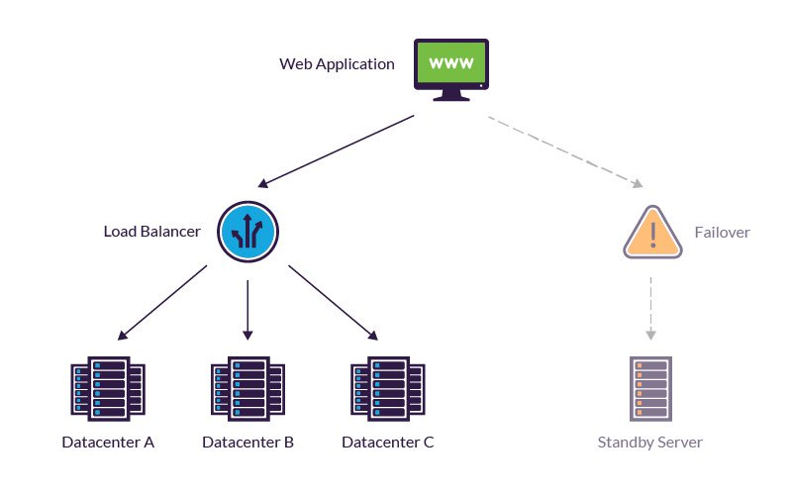
Fault Tolerance in Cloud Computing
Fault tolerance is the ability of a cloud system to continue operating correctly even when failures occur.
Types of Failures
Failures in cloud can occur due to:
Hardware failures Server crashes, disk failures, power issues
Software failures Application bugs, operating system crashes
Network failures Connectivity loss, high latency, packet drops

Slide 4
Reasons for Fault Occurrence
Faults in cloud systems can occur due to multiple reasons, including:
Hardware failures Server, storage, or power component breakdowns
Software bugs Application errors or system crashes
Network issues Connectivity loss or unstable network conditions
Human errors Misconfiguration, accidental deletion, or incorrect operations
Natural disasters & external events Power outages, earthquakes, floods
Security breaches Cyberattacks, malware, or denial-of-service attacks

Slide 5
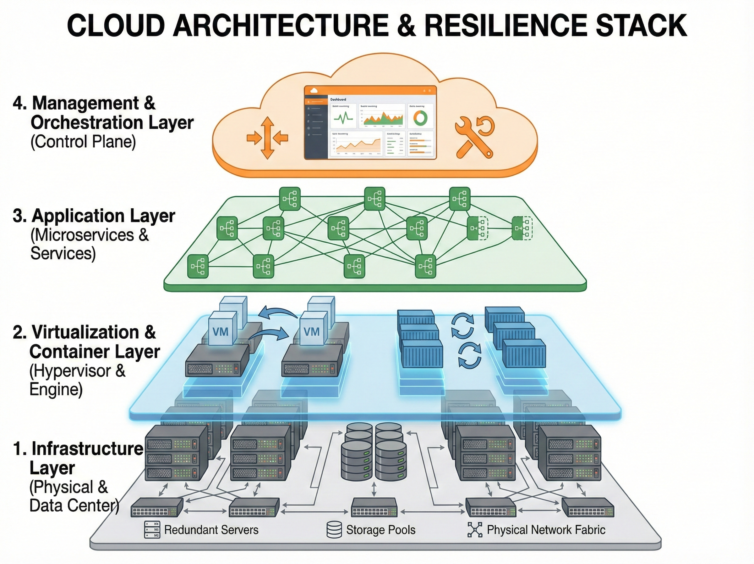
Fault Tolerance at Different Level
1. Infrastructure Layer
Redundant servers, storage, and networks
Failover between physical machines
Multiple availability zones or data centers
2. Virtualization & Container Layer
VM migration if a host fails
Containers restarted automatically on healthy nodes
Isolation between workloads
3. Application Layer
Microservices architecture
Replication of services
Graceful degradation when one service fails
4. Management & Orchestration Layer
Health monitoring
Auto-scaling
Self-healing (restart, replace, reschedule)

Slide 6
Fault Tolerance at the Infrastructure Layer
Virtual Machine (VM) Migration If a physical host fails, virtual machines can be migrated or restarted on another host with minimal downtime.
Isolation Between Workloads Failures in one VM or container do not affect others running on the same infrastructure.
Container-Based Fault Recovery Containers can be stopped, restarted, or rescheduled quickly on healthy nodes.
Lightweight & Portable Deployment Containers enable applications to run consistently across environments, improving recovery speed.

Slide 7
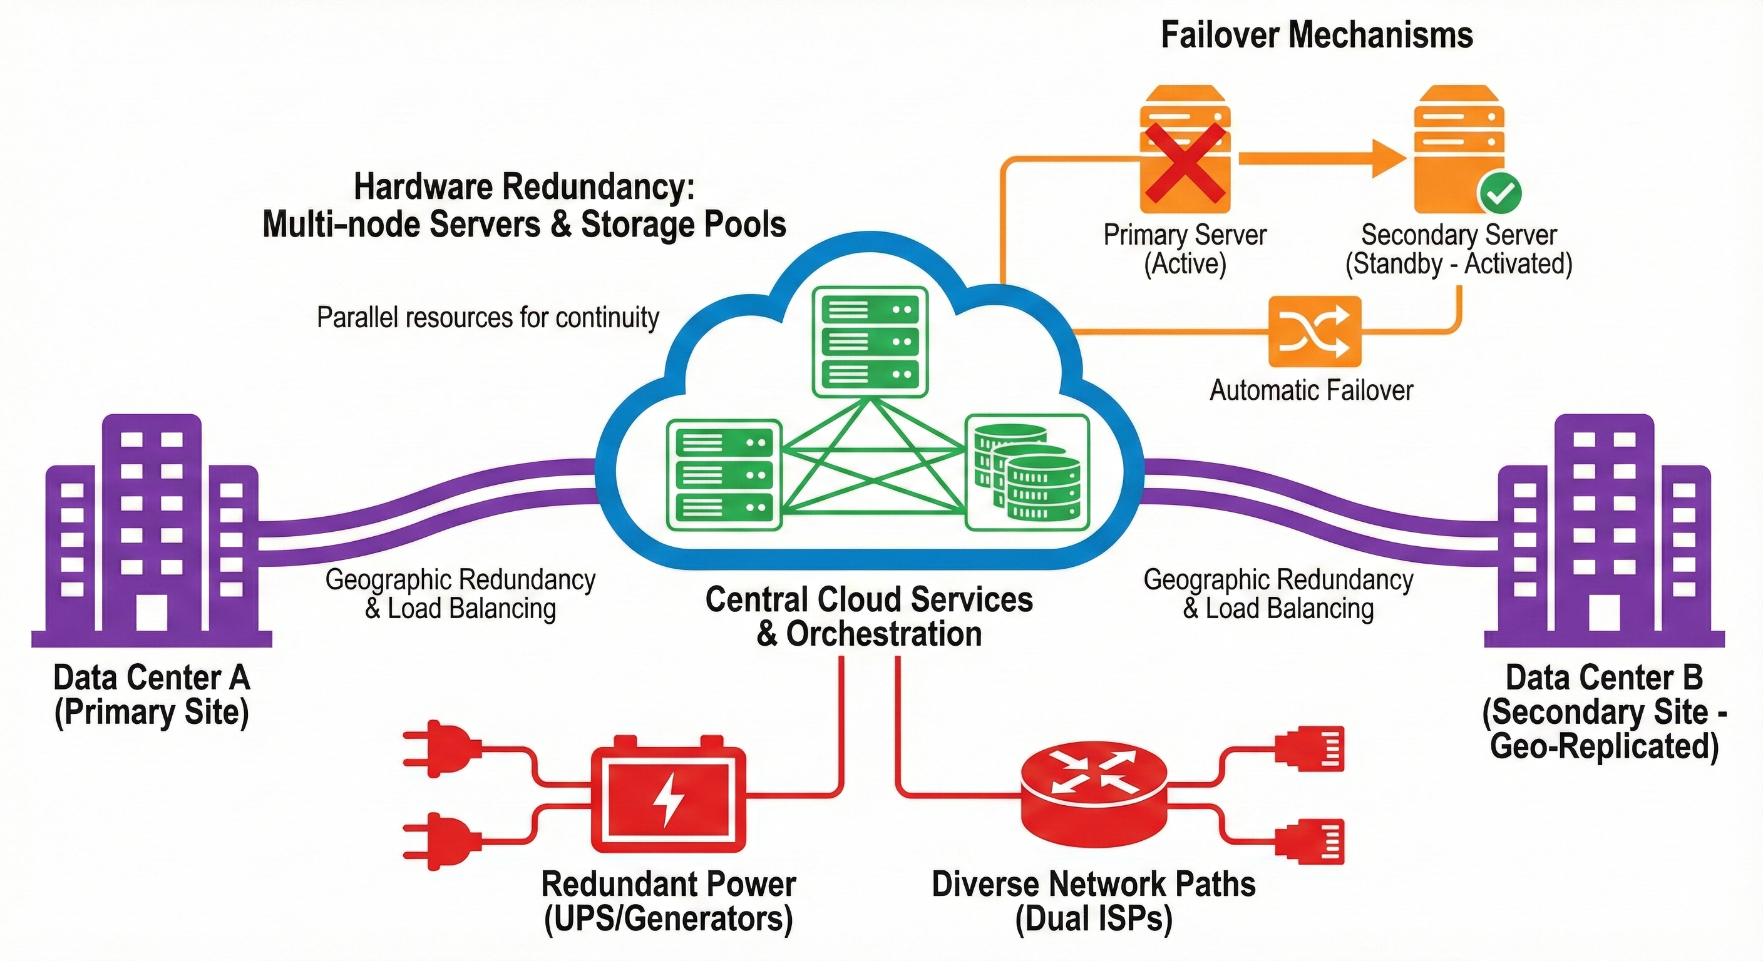

Slide 8
Fault Tolerance at the Virtualization & Container Layer
Hardware Redundancy Multiple servers, storage devices, and network components are used so failure of one does not stop the system.
Failover Mechanisms If a physical server or component fails, workloads are automatically shifted to a healthy one.
Multiple Data Centers / Availability Zones Cloud services are deployed across geographically separated locations to survive large-scale failures.
Redundant Power & Networking Backup power supplies and network paths ensure continuous operation during outages.

Slide 9
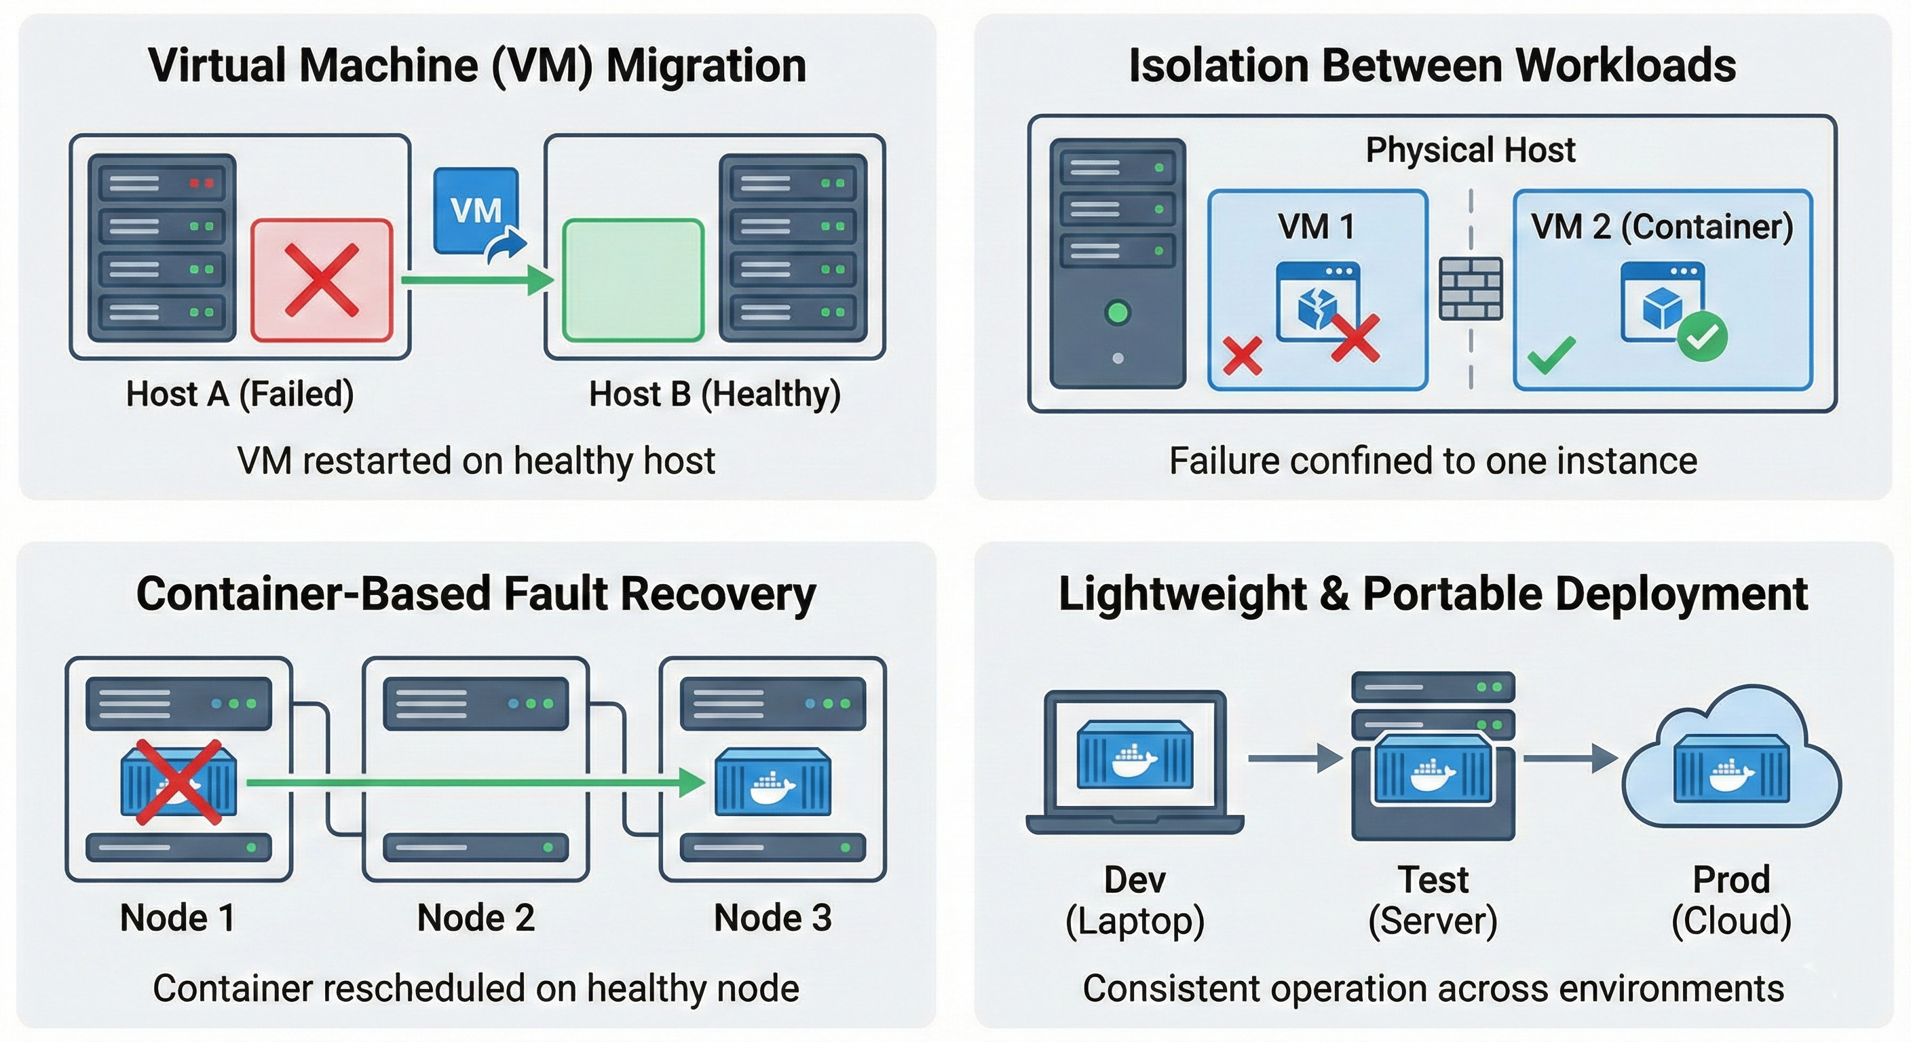

Slide 10
Fault Tolerance at the Application Layer
Microservices Architecture Applications are divided into small, independent services. Failure of one service does not affect the entire application.
Service Replication Multiple instances of the same service run simultaneously. If one instance fails, another continues handling requests.
Graceful Degradation When a service fails, the application continues operating with reduced functionality instead of crashing completely.
Timeouts & Retries Failed service calls are retried or timed out to prevent cascading failures.

Slide 11
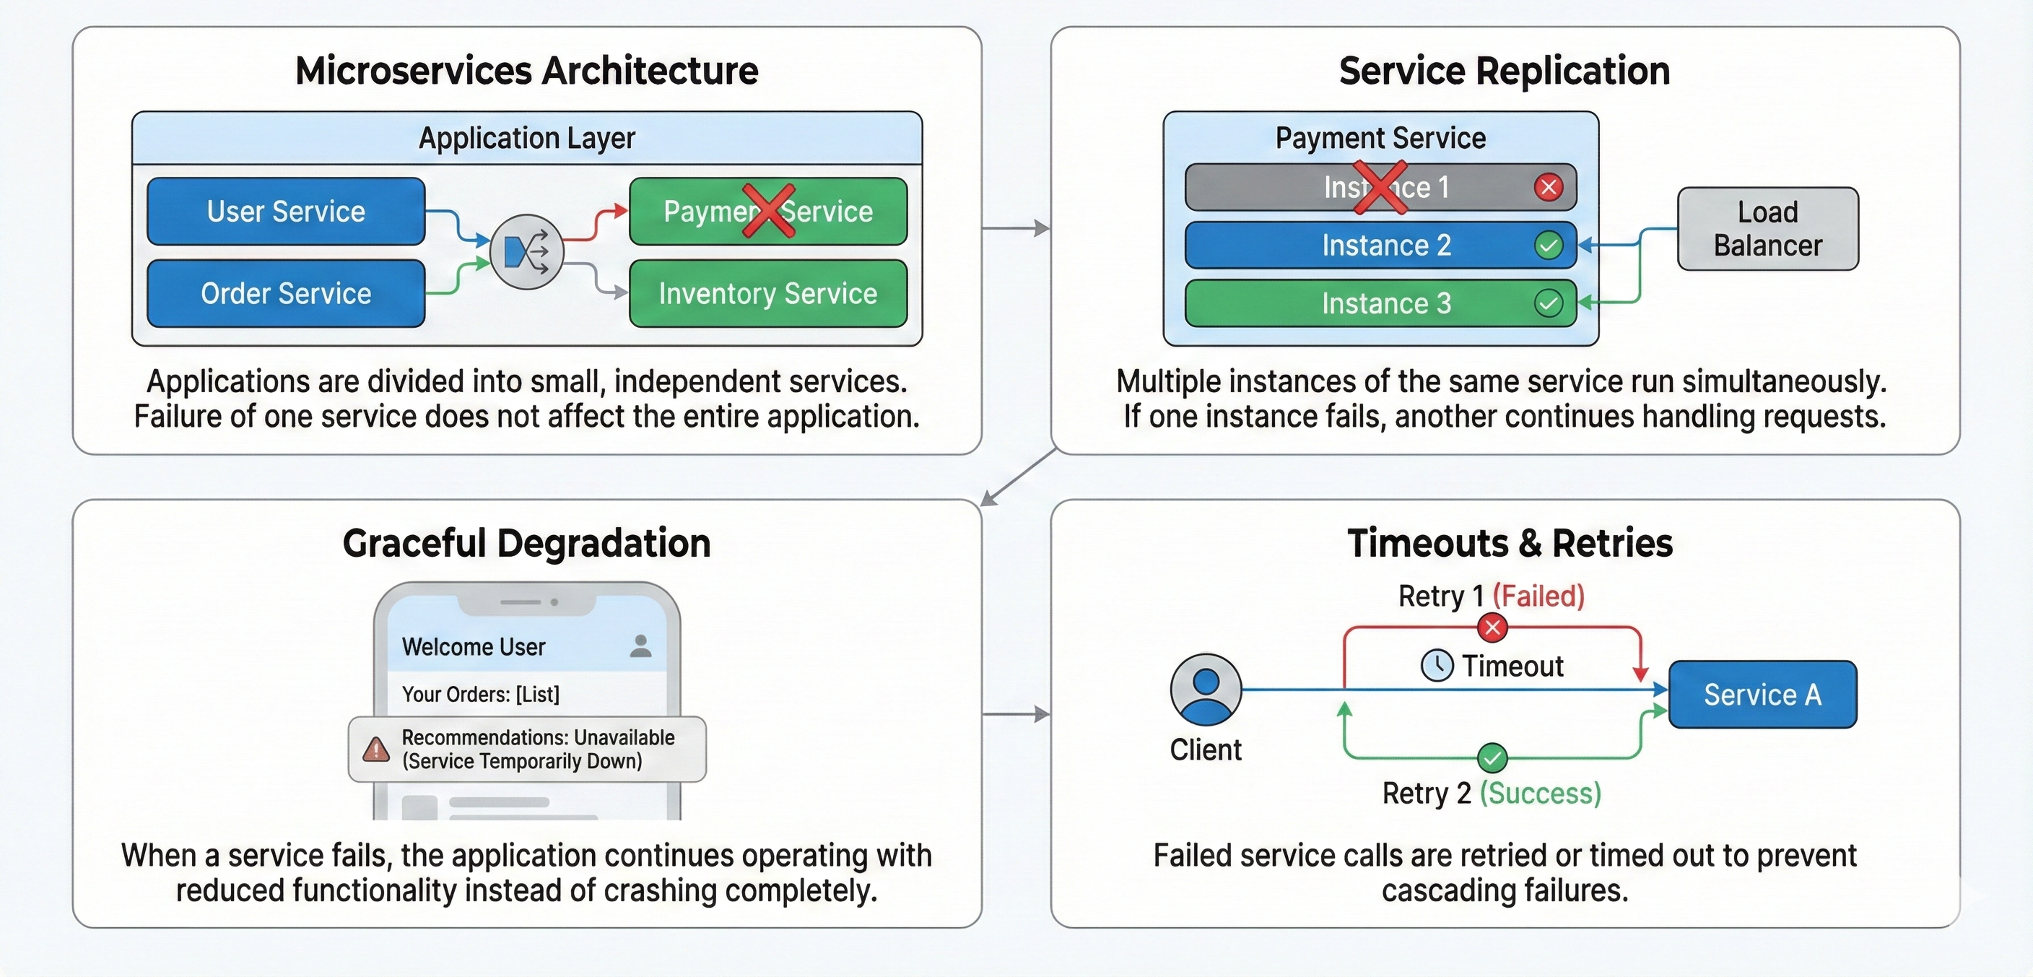

Slide 12
Fault Tolerance at the Management & Orchestration Layer
Health Monitoring Continuously checks the status of servers, VMs, containers, and services to detect failures early.
Auto-Healing (Self-Healing Systems) Failed components are automatically restarted, replaced, or rescheduled without manual intervention.
Auto-Scaling Resources are automatically increased or decreased based on load and failure conditions to maintain performance.
Service Orchestration Tools like Kubernetes manage deployment, scaling, and recovery of services across nodes.

Slide 13
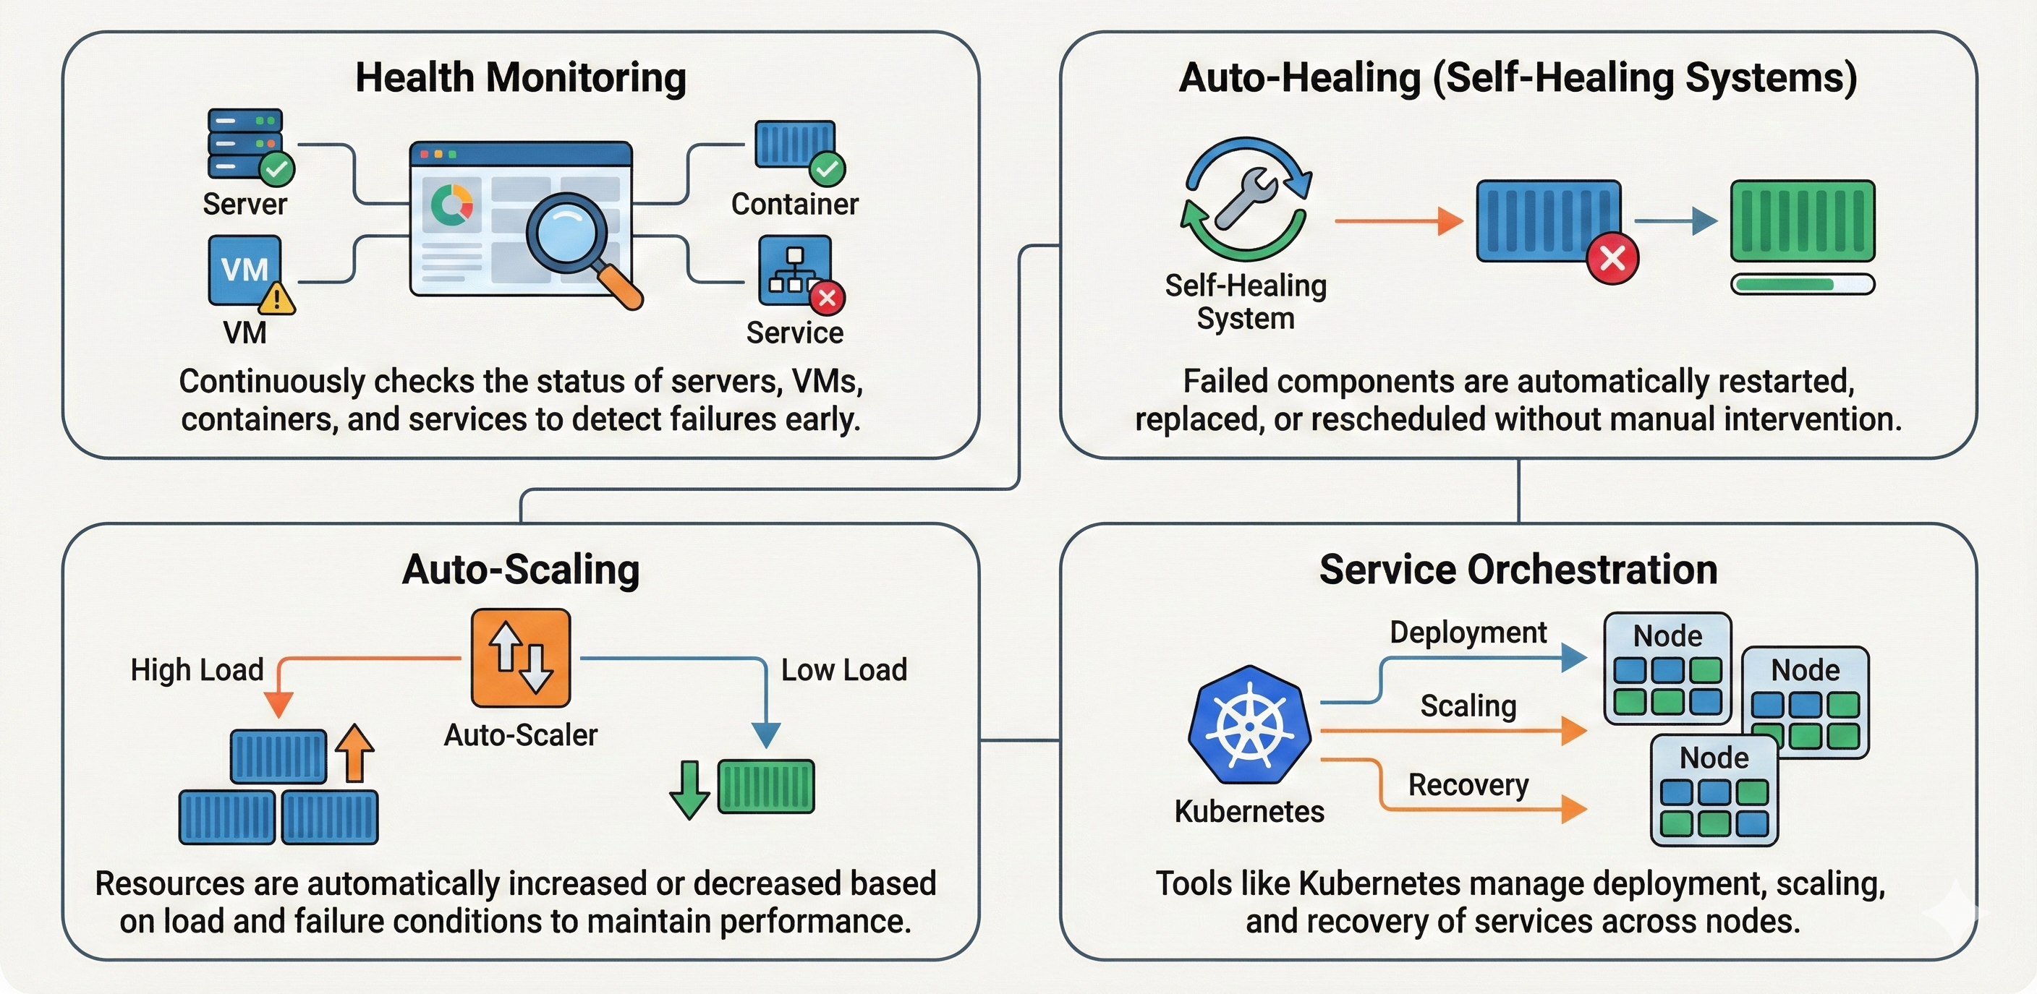

Slide 14


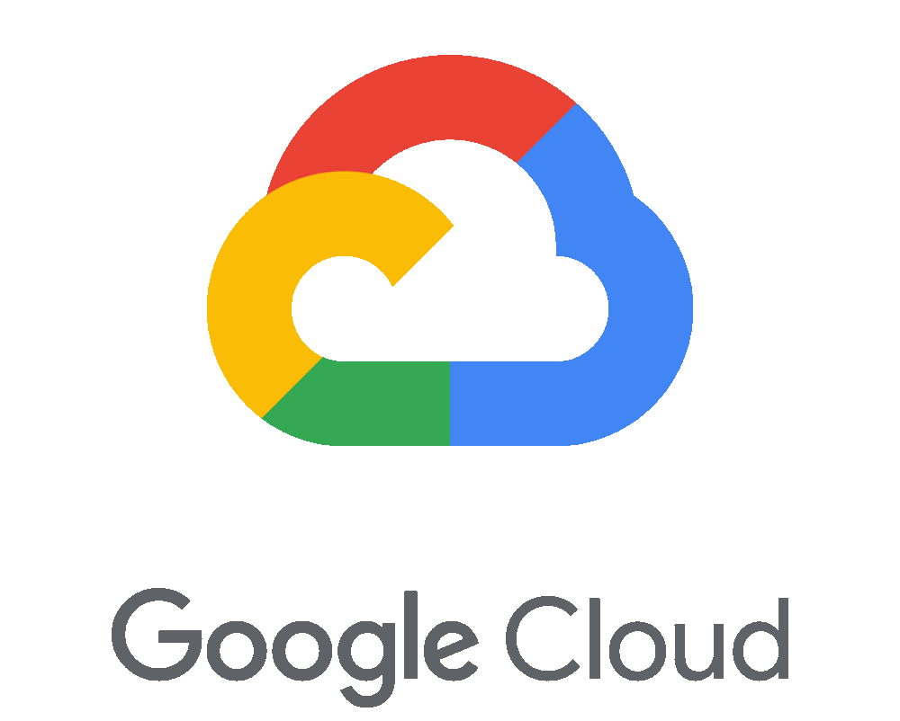
Fault Tolerance in Major Cloud Platforms
Amazon Web Services (AWS)
Elastic Load Balancing (ELB) helps distribute contents among multiple instances.
AWS Auto Scaling provides automatic addition and removal of resources.
AWS Fault Injection Simulator is meant to simulate the faults and test the resilience of the system.
Microsoft Azure
Azure Site Recovery has been a prime disaster recovery solution.
Availability Zones provide redundancy in separate geographic locations.
Azure Traffic Manager ensures that the applications are available.
Google Cloud Platform (GCP)
Google Kubernetes Engine (GKE) allows containerized applications to self-heal.

Slide 15
Advantages of Fault Tolerance in Cloud Computing
High System Availability Ensures continuous service with minimal downtime.
Data Integrity & Security Protects data from loss, corruption, or damage.
Improved Performance & Efficiency Load balancing enables optimal use of resources.
Cost Savings Prevents revenue loss caused by unexpected system failures.
Better User Experience Provides seamless and reliable access to applications and services.

Slide 16
Challenges of Fault Tolerance in Cloud Computing
System Complexity Managing fault tolerance across distributed services and multiple data centers is complex.
Cost vs. Reliability Redundancy and replication improve reliability but increase operational costs.
Scalability Challenges Fault tolerance mechanisms must scale efficiently as cloud systems grow.
Dynamic Cloud Environment Frequent updates and rapid service deployment require adaptable fault tolerance strategies.
Human Error Misconfiguration or operational mistakes can weaken fault tolerance despite good system design.

